Slide 1
Online communication channels

Slide 2
?

Slide 3
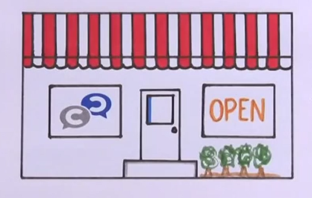
Video: https://www.youtube.com/watch?v=voKVLZSvLsI
https://www.youtube.com/watch?v=MpIOClX1jPE

Slide 4
Why going viral?
It allows us to expand our reach, foster engagement, and increase access to credible messages;
Engage with the (wider) public;
Engage with specific targeted audience;
Disseminate information in a timelier manner;
Increase the potential impact of important messages;
Create different (more personalized) messages to reach diverse / particular audiences;
…

Slide 5
“If you are not on Facebook, you don’t exist! (?)”
TRUE or FALSE

Slide 6
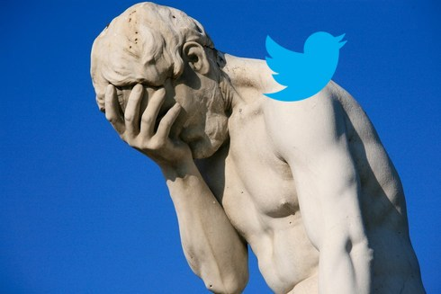
“If you are not using social media to communicate and connect, you might as well live in a cave, or the grounded shell of a space shuttle.” - Online Business Strategist

Slide 7
Key benefits of social media
SOCIAL MEDIA:
can encourage participation, conversation, and community - all of which can help spread key messages, influence decision making, and promote behavior change.
helps to reach people when, where, and how it is convenient for them, which improves the availability of content and might influence satisfaction and trust in messages delivered.
is also a key tool in building awareness and credibility.

Slide 8
An example of a good social media campaign….

Slide 9
Example from WATERisLIFE
The organization set out to reverse the popular #firstworldproblems trend used to voice silly complaints of the privileged tweets such as:
"I hate it when my phone charger won’t reach my bed."
"When I go to the bathroom and I forget my phone"
"I hate when my leather seats aren’t heated."
"When my mint gum makes my ice water taste cold“
“I hate it when my house is so big I need two wireless routers.”

Slide 10
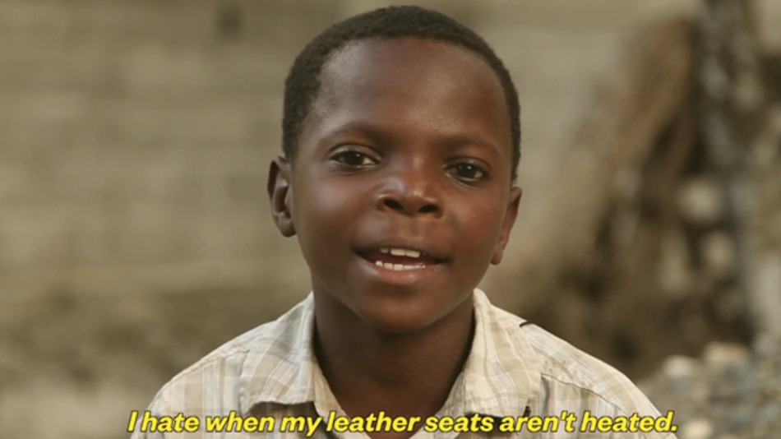
#firstworldproblems
Videos: https://www.youtube.com/watch?v=fxyhfiCO_XQ https://www.youtube.com/watch?v=VmdkRQ_6-qE https://www.youtube.com/watch?v=GosoL3HYJBc

Slide 11
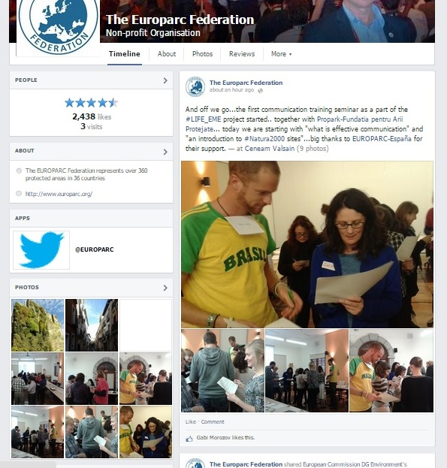
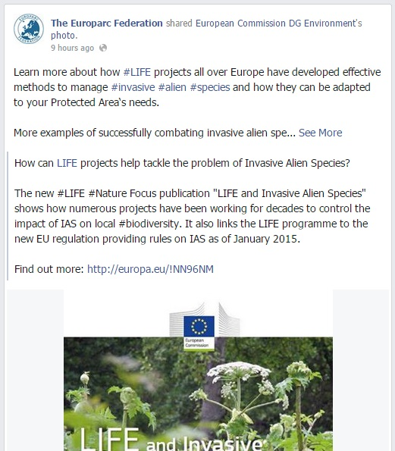

Slide 12
Always look at the BIG PICTURE !
Social media is ONLY one tool in a larger communication strategy! Always consider your overarching communication goals when developing social media activities!
As with all media outreach, the keys to an effective social media presence are to:
Identify your target audience.
Determine your objective.
Select the appropriate channel for your message.
Decide upfront how much time and effort you can invest.

Slide 13
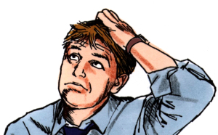
Which Social Media to choose?
Know your target audience!
Know your capabilities of communicating through that media!
Use appropriate social media for audience segmentation.

Slide 14
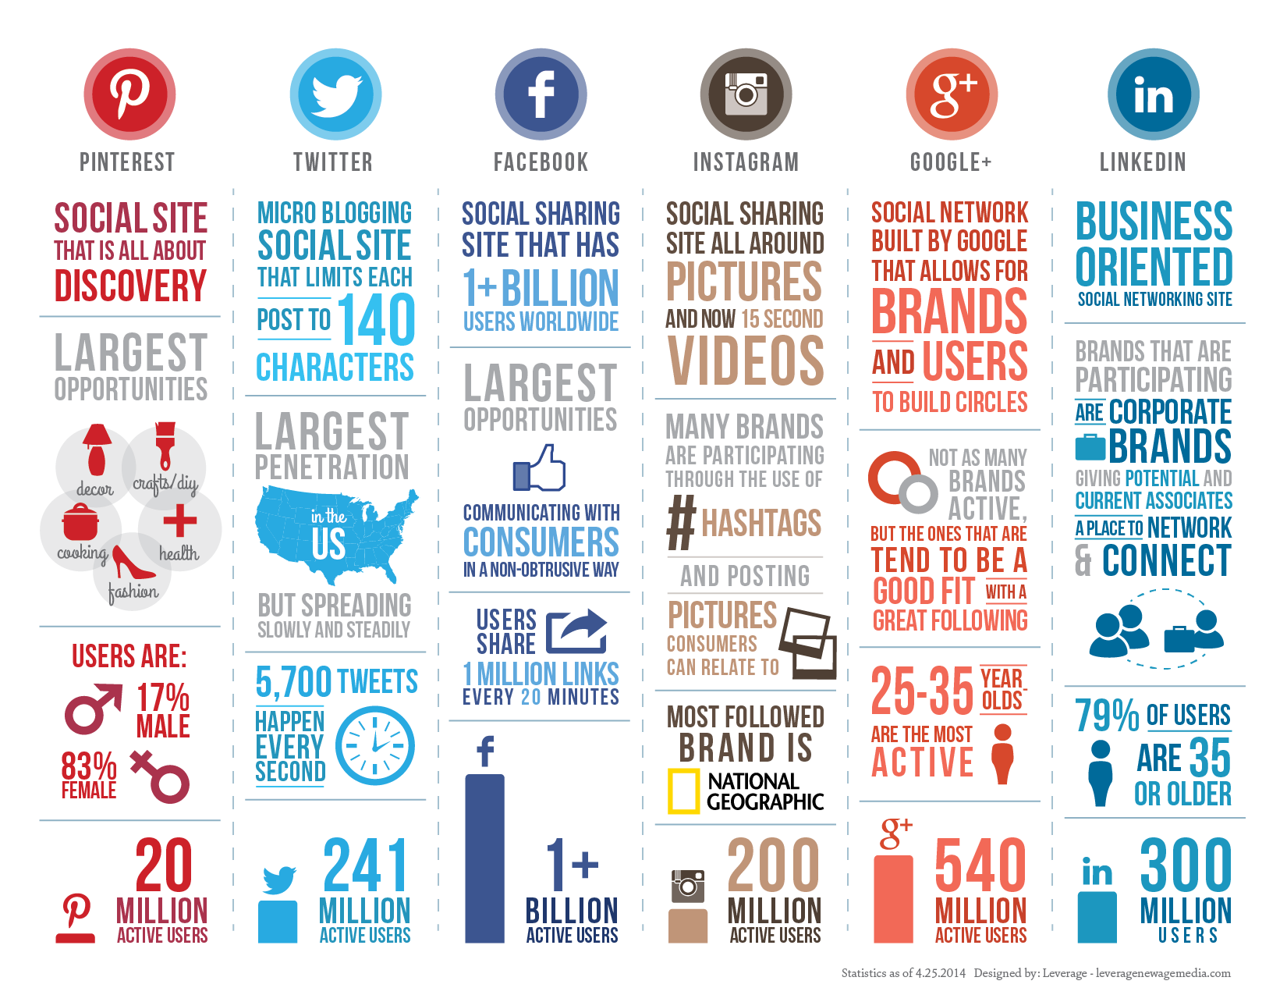
Example of social media segmentation use…

Slide 15
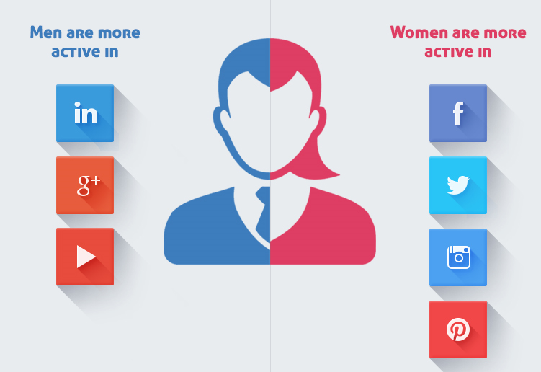

Slide 16
6 social media types of users

Slide 17
And some other users…

Slide 18
Where to start?
Assuming you’ve done your market research and identified the right social media for your audience:
Open an account;
Personalize your account to your brand;
Connect your account to other communication channels: (already existing ones and future ones)
Inform your audience of your new channel through an existing channel;
Get active…

Slide 19
Incorporating social marketing into your communications…
Highlight the positive aspects of your message.
Answer the audience’s question, “What’s in it for me?”
Respect your audience.
Encourage your readers to take a particular action or to learn more.
Tie messages to specific products/topics or services/activites when possible

Slide 20
Principles of Effective Social Media Writing - Creating Content
Social media content should be:
Relevant, useful, and interesting
Easy to understand and share
Friendly, conversational, and engaging
Action-oriented
Your target audience can receive multiple messages from multiple sources every day, try to make your messages relevant, useful, and interesting so your audience will interact and be engaged.

Slide 21
An example…
Easy Engagement: The post has two simple options that make it easy to engage. Good use of large, enticing images, making it easy for users to make the decision.
Seasonal Relevance: Using ice cream in the summer is a great example of tapping into what your Fans are already thinking about.
Re-Engagement: Seeing how the contest is running may drive Facebook users back to the page.

Slide 22
Use Your Web Content as Source Material for Social Media Content
Writing for social media can be a demanding task. One way to cope is to tweet, post, and text about Web content you have already created.
Make Social Media Writing Easier by Repurposing Web Content.

Slide 23
A few cases that went wrong…

Slide 24
In this post they had an idea with entertainment but in the execution they gave away the answer. And so it feels like they didn’t trust their audience to figure it out for themselves.
Let your audience have the experience.

Slide 26
Remember the 3 E’s
The best way to engage your fans is to make sure your post falls into one of 3 categories –the 3 E’s:
Entertain: If your post is either funny or entertaining in some way, it will get shared more.
Educate: When you educate your audience about your niche or provide a helpful tip, your post will perform better.
Experience: If you provide some type of experience – you move your audience emotionally, then your post will get more comments, likes, and shares.

Slide 27
According to research that was completed by the Twitter Media blog, the most effective Tweet features to increase engagement include the following:
Photos average a 35% boost in Retweets
Videos get a 28% boost
Quotes get a 19% boost in Retweets
Including a number receives a 17% bump in Retweets
Hashtags receive a 16% boost

Slide 29
Components of a social media post
# before a relevant keyword or phrase (no spaces) in a post - to categorize those posts and help them show more easily when searching
@ @replies, @tags - auto-suggest dropdown based on what you've typed after the @ symbol
Video/ Photo material
Hyperlinks – www….
Text, Text, Text….

Slide 30
Checklist

Slide 31
1. Length: Posts can be up to 60 000 characters (including spaces).
2. Access to more information:
• Hyperlink to a Web page, photo, or video.
• Include information available through other social media channels: a short code for texts; a hashtag for Twitter.
3. Call to action: Invite followers to do something such as watch a video, attend an event, or use CDC resources.
4. Tone: Write in a friendly, casual style. Avoid jargon.
5. Tagging: Use the @ symbol in front of a name you are addressing to in your post to automatically create a link and display the post on the partner’s page.
6. Abbreviations: Avoid abbreviations, but if they are necessary, use only if easily understood.
1. Length: Tweets should be 140 characters or less, including a shortened URL.
2. Access to more information: Include a hyperlink to a website, an @ mention, or a hashtag #.
3. Call to action: Start the tweet with a verb if possible: Use watch, read, learn, etc.
4. Tone: Write in friendly, action-oriented style.
5. Mentions: Use the “@“ symbol in front name in your post to automatically create a link and display the post on the partner’s profile.
6. Abbreviations: Avoid abbreviations, but if they are necessary, use them only if they are easily understood, do not change the meaning of the tweet, and are not immature or unprofessional.

Slide 32
Exercise
You will be given cards. Find your group. There should be 3 or 4 of you in each
Identify key words
Call for an action
Don’t forget to tag the topic words, possible participants
Include location
Visual content works best

Slide 33
Direct mailing – Newsletters
Email is (was?) the most cost-effective and highest ROI (return on investment) communication (marketing) medium.
Email provides excellent measurability: you can measure who opens and clicks on your email: you know exactly who in your audience is engaged but also what information is interesting and of value to them.
Your content is what will keep your customers reading your email!
Often emotional unsubscribing

Slide 34
An example…

Slide 35
Social Media vs. Newsletters
Target market:
social media = over hundreds of thousands or even millions of individuals ( many of whom may have little or no interest in you)
newsletter = smaller, yet much more motivated, group of consumers, customers or clients
When properly developed, each approach can be effective in building customer base and brand/idea loyalty.
When the two are combined, the total effectiveness is noticeably greater than the sum of the two parts.

Slide 36
Blogs
Numerous reasons why it makes sense to blog and communicate about N2000 sites and nature in general;
1. Establishing expertise.
2. Establishing “real” credibility.
3. Building a professional community.
4. Creating relationships with stakeholders.
5. Drive targeted traffic to your main web site.

Slide 37
Website
Should be the cornerstone of the race communication plan.
The strongest marketing tool and often the first place participants go to get information.
A “window” to your organisation and work….
Must reflect your work or can send out a wrong image of you!

Slide 38
Conclusions
You don’t have to do it!
Don’t share just to share!
Choose one or two media and learn properly how to work with it
#Don’t #over #hashtag
Be human – avoid automatic replies and similar auto services for social media
Remember: it is a two way street: Once you stop talking at your audience, and begin engaging with them you’ll become much more valuable in their minds.
It truly is a double edged sword. Use it carefully.

Slide 39
Open your laptops! ☺

Slide 40
For more information:
Visit us on our website: www.europarc.org
Like us on Facebook: www.facebook.com/EUROPARC
Follow us on Twitter www.twitter.com/EUROPARC
Send us an e-mail office@europarc.org
Or simply give us a call! 0049 176 8105 78 27

